Slide 1

Info 257 Final Project
Rishabh Wason, Eugene Lee, Omar Buenrostro, Jin Kweon, Jiyoon (Clover) Jeong

Slide 2
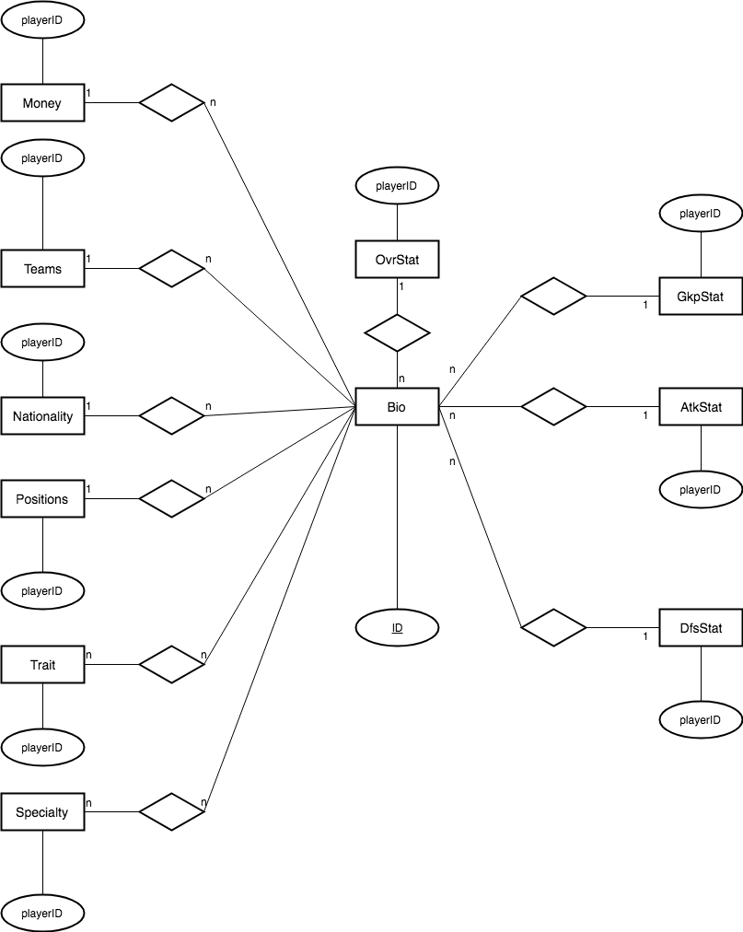
The Database Design

Slide 3
Players have
overall stats
attacking stats
defense stats
goalkeeper stats
position stats
money stats
traits
specialties
Players play on
teams
leagues
countries

Slide 4
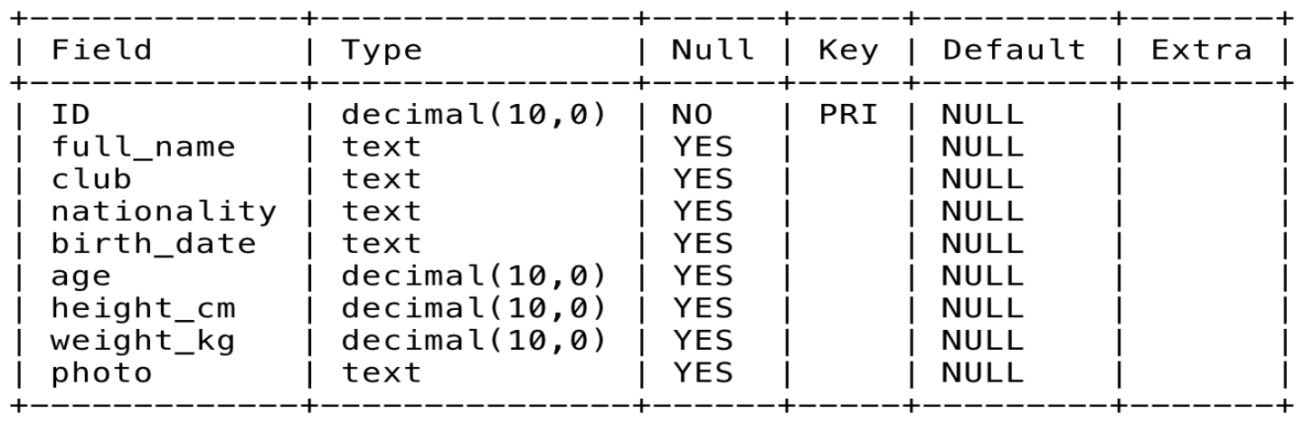
Players_bio

Slide 5
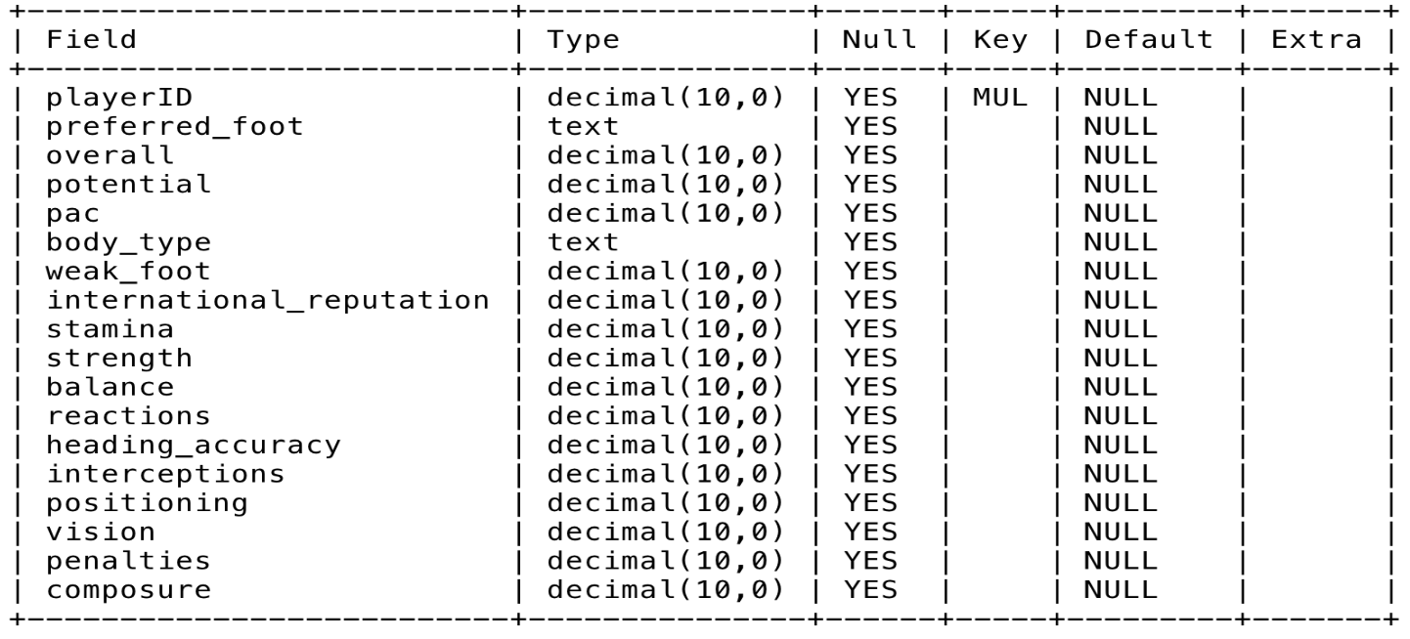
Overall_stat

Slide 6
Intended Use Cases
Problems:
Lots of resources but unorganized data -> unhelpful!
How the database will help:
Easily access player information: player statistics, teams, leagues, etc.
Wide audience: targeted for both soccer experts and non-experts
Even the soccer ignoramus could find player information with little difficulty
Notes:
Problems:
Although there are many websites we could use to find about the players, but we found that none of them are really helpful, since they are mostly unorganized.
How the database will help:
The main use for the database will be to see player statistics and what teams/leagues they are part of.
Our target would be really wide (for both non-experts and experts). People who do not know soccer could use our database, to find the players’ information, teams, leagues, etc

Slide 7
Use Cases:
The world-wide event, FIFA World Cup, is approaching and we would like to come up with the database that could help people find the players they want to support.

Slide 8
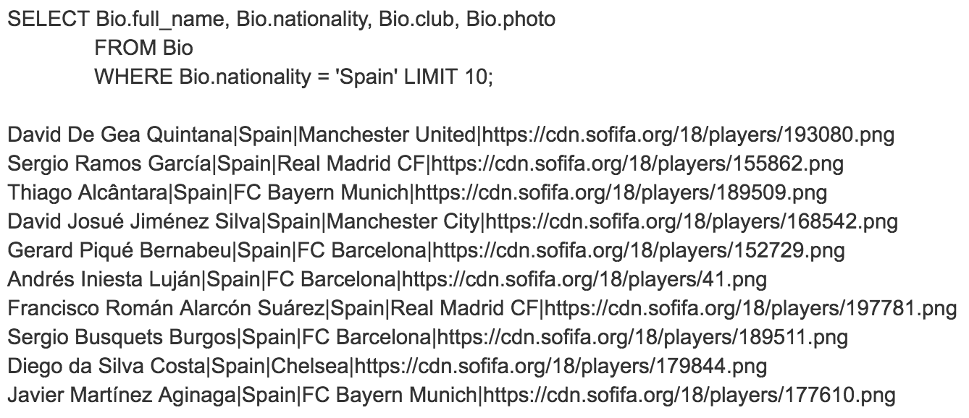
Query 1: I am interested in finding ten players who are in specific teams and have the same nationality(for example, Spain).

Slide 9
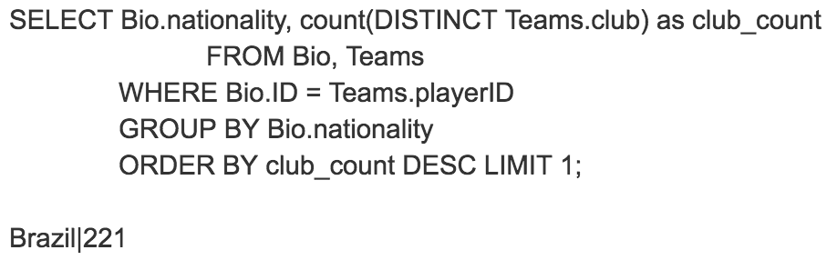
Query 2: Which country has the most players at foreign clubs?

Slide 10
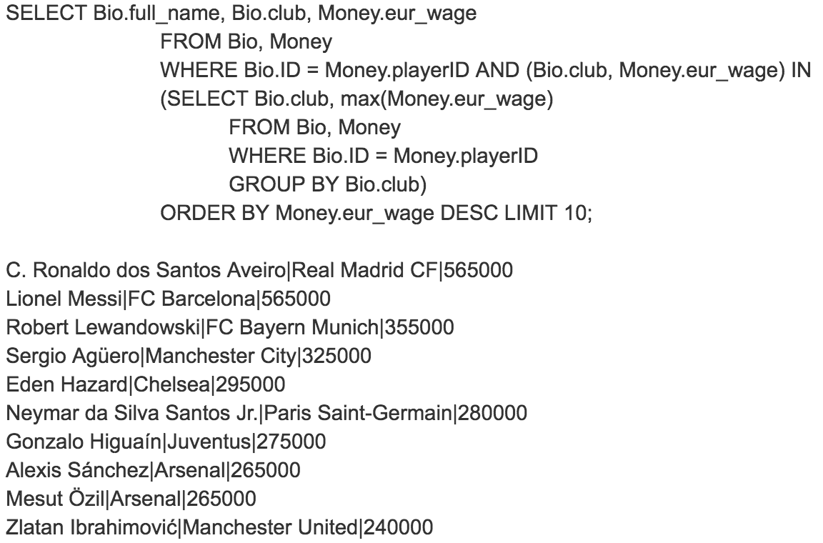
Query 3: Who are the top 10 highest-paid player for each team?

Slide 11
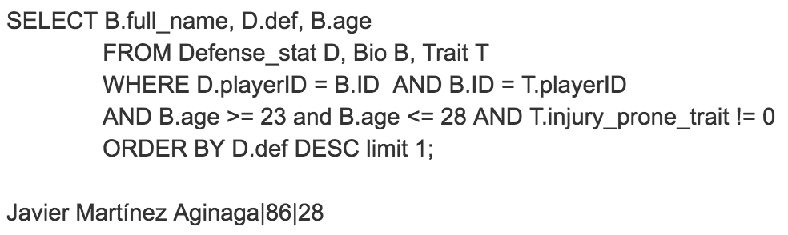
Query 4: We want a defender, aged between 23 - 28 year-old who is likely to get injured

Slide 12
A demonstration of your user interface for the database.1
A good starting point is to include table descriptions, SQL queries that match your use cases and their results. A successful demo during your presentation would greatly help on this point.
Please include some screenshots and explain any non-obvious design decisions. Again, the demo should help convince us of this.
As a general rule, asking users to enter IDs of entities does not make for a usable interface. If your interface requires them to enter IDs, make sure to explain why.

Slide 13
Challenges in Development
Notes:
tell us both what you really wanted to make and what you've got, why you couldn't get it to work as it wanted and what you would do it you had more time. You'll get partial credit for well-thought out interface that you couldn't implement.

